Slide 1

Introduction to Winlink
Upshur Area Amateur Radio Club
13 JANUARY 2025
Notes:
Why is this a big deal?
Who uses it and for what purpose.
What can you do with it.
How to get started.

Slide 2
Outline
What is Winlink
Why use Winlink
What’s the Big Deal
Winlink Architecture
Winlink System Components
Getting Started
Ways to send messages
Examples with emails and text
Recap – Q&A
Notes:
Victor "Vic" Poor (July 12, 1933 – August 17, 2012) was an American engineer and computer pioneer. At Computer Terminal Corporation (later renamed Datapoint Corporation), he co-created the architecture that was ultimately implemented in the first successful computer microprocessor, the Intel 8008. Subsequently, Computer Terminal Corporation created the first personal computer, the Datapoint 2200 programmable terminal.

Slide 3
What Is Winlink?
The real jewel in the crown of HF digital modes. Widely used for EmComm. Beginning to be the most useful tool benefiting EmComm.
Winlink is a worldwide radio messaging system that uses amateur-band radio frequencies to provide radio interconnection services.
These services include email with attachments, position reporting, weather bulletins, emergency and relief communications, and message relay. These are text based/email style messages.
The system is built and administered by volunteers and is financially supported by the Amateur Radio Safety Foundation.
It can operate completely without the internet--automatically--using smart-network radio relays and Peer to Peer communications.
Notes:
Written messages that show who is providing the information or request. Built-in forms provide a framework for easy ways to ham to fit into most served agencies with professional documentation that is traceable.
You can be confident that the message was sent and received.

Slide 4
What Is Winlink?
Do I need a ham license to use Winlink?
Yes. You need a valid amateur radio service license from your country's licensing authority to create a Winlink account. You can also use a license or authorization from a government agency or program that participates with Winlink for emergency communications. Licenses for marine radiotelephones, LMR, GMRS, or ship stations are not valid.
How much does Winlink cost?
Free or $24 purchase registration key to support the Winlink system.
Only runs on Windows OS.
Notes:
Written messages that show who is providing the information or request. Built-in forms provide a framework for easy ways to ham to fit into most served agencies with professional documentation that is traceable.
You can be confident that the message was sent and received.

Slide 5
Why Use Winlink?
Our served agencies prefer written messages, if possible, that show who the source is and what action is being requested.
Resilient - Mature, well-tested and full featured system.
Many ways to get the message sent – with confidence.
Worldwide system for sending/receiving e-mail via radio.
Bridge different radio capabilities (HF/VHF/UHF).
Able to collect messages while unattended. How is that possible.
Built-in forms provide credibility, critical information and traceability.
Notes:
Written messages that show who is providing the information or request. Built-in forms provide a framework for easy ways to ham to fit into most served agencies with professional documentation that is traceable.
You can be confident that the message was sent and received.

Slide 6
What’s the Big Deal?
“It's Better To Have It And Not Need It, Than To Need It And Not Have It” Woodrow F. Call (Lonesome Dove)
Hams supporting emergency communications once normal communications has failed. Why isn’t my email working and what is wrong with my phone?
Winlink is just another tool for your EmComm toolbox. We are communicators and need to use any means available.
Telnet and RMS messages can be sent to non-ham radio operators.
Can operate at a lower bandwidth. 500 Hz is what Texas RACES uses for Peer-to-Peer (P2P) messages.
Extensive forms capability, including ICS and ARC library.
Skilled Winlink operators were in demand to support the aftermath of Hurricane Helene & other recent disasters.
Notes:
Written messages that show who is providing the information or request. Built-in forms provide a framework for easy ways to ham to fit into most served agencies with professional documentation that is traceable.
You can be confident that the message was sent and received.

Slide 7
Winlink System Components
CLIENT SYSTEM (YOU) – Radio, computer, Winlink Express & VARA software plus interface (sound card).
RADIO MESSAGE SERVER (RMS) – Radio gateway between the client (YOU) and the Winlink system backbone. Client stations connected by RF to an RMS station.
COMMON MESSAGE SERVERS (CMS) – Winlink system backbone server that is situated in the Amazon Web Service (AWS) cloud.
RADIO-ONLY MODE – This consists of RMS stations that can auto-forward by RF, independent of internet availability.
Notes:
Written messages that show who is providing the information or request. Built-in forms provide a framework for easy ways to ham to fit into most served agencies with professional documentation that is traceable.
You can be confident that the message was sent and received.

Slide 8
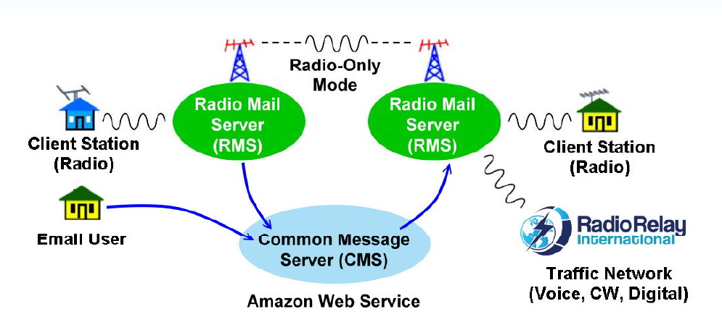
Winlink Architecture (RMS)
YOUR STATION
(Winlink, Gmail, Outlook, etc.) With internet connection - Starlink
Email Users
(Winlink, Gmail, Outlook, etc.)
Notes:
Written messages that show who is providing the information or request. Built-in forms provide a framework for easy ways to ham to fit into most served agencies with professional documentation that is traceable.
You can be confident that the message was sent and received.

Slide 9
Let’s Get Started
Go https://winlink.org/ download the client application
Look for the:
Click on the ‘Download’ tab.
Select ‘User Programs’
The last one on the list is ‘Winlink_Express_install_1-7-20-0.zip’ Download and install software.
Accounts off-air for 400 days are automatically purged. Use it or lose it!
Notes:
When Winlink has been installed on you PC or Mac it will look for updates each time you start the program. I t will also ask you to update the forms it contains. All you do is say ‘yes’.

Slide 10

Let’s Get Started
Look for this Icon on your desktop:
Notes:
When Winlink has been installed on you PC or Mac it will look for updates each time you start the program. I t will also ask you to update the forms it contains. All you do is say ‘yes’.

Slide 11
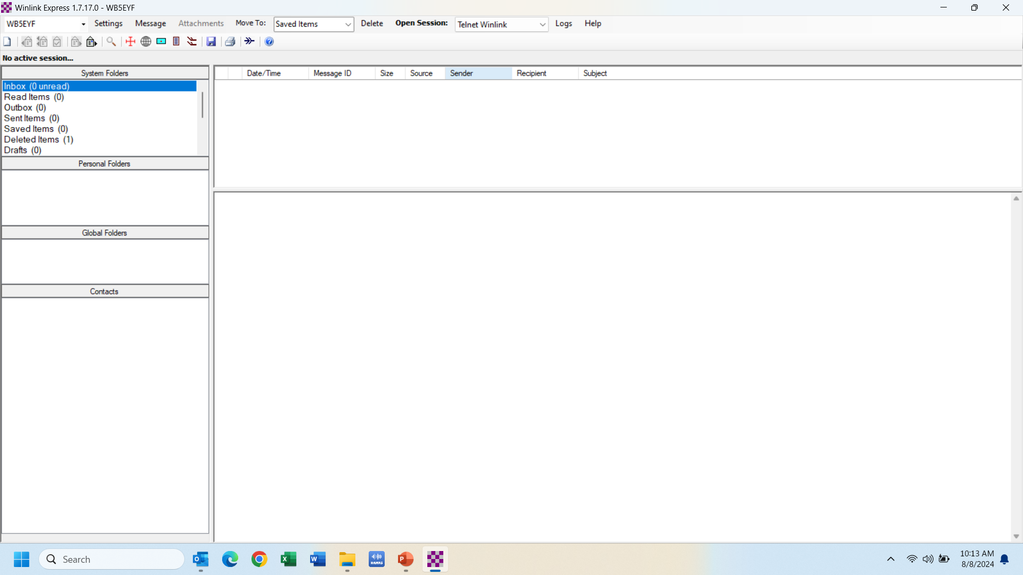
Click Settings and select the top item to setup Winlink Express. Select (Winlink Express Setup) from the pull down

Slide 12
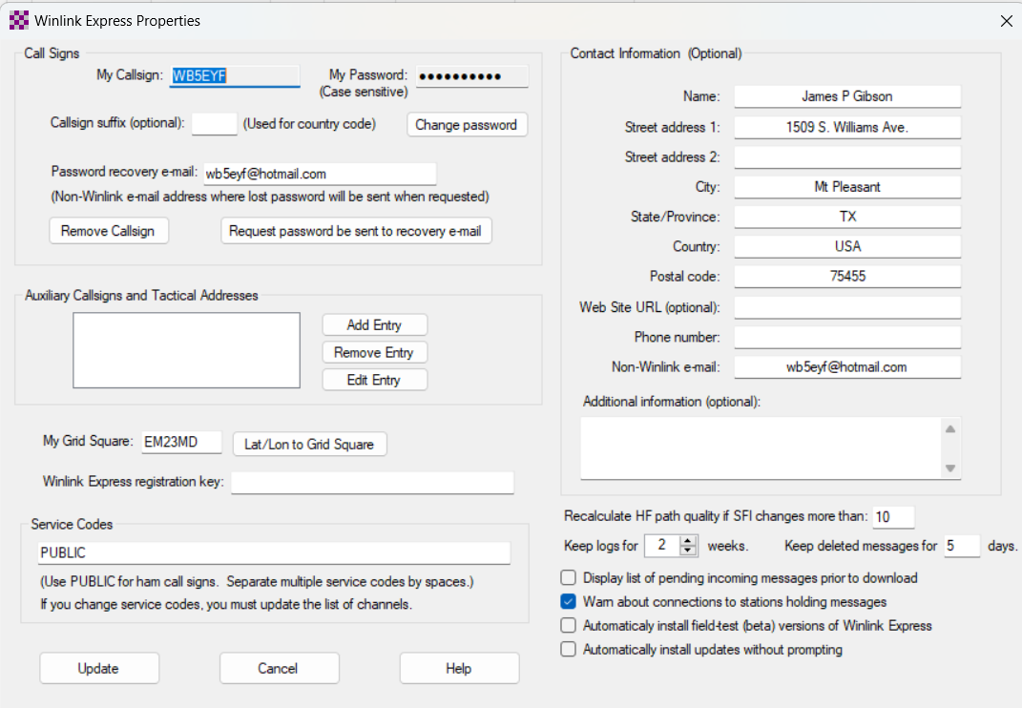
Fill out the Settings Form Fields
2
1
3
4
5
Click Update when finished

Slide 13
Ways to Send Messages
Telnet Winlink – Direct to internet (internet connection)-Starlink
VARA HF – HF RMS nodes regionally (RF connection)
VARA HF P2P – Direct Peer-to-Peer RF communication (RF connection)
VARA FM - VHF/UHF RMS nodes regionally (RF connection)
VARA FM P2P – Direct Peer-to-Peer RF communication (RF connection)
Packet – ETECS has a digipeater on 145.010 in Gilmer. You can use Radio Mail to get Winlink message on a smart phone. (I am not knowledgeable with this mode)
Notes:
When Winlink has been installed on you PC or Mac it will look for updates each time you start the program. I t will also ask you to update the forms it contains. All you do is say ‘yes’.

Slide 14
Start practicing with Telnet (Click on Telnet Winlink)
Open Session (Click on Open Session)

Slide 15
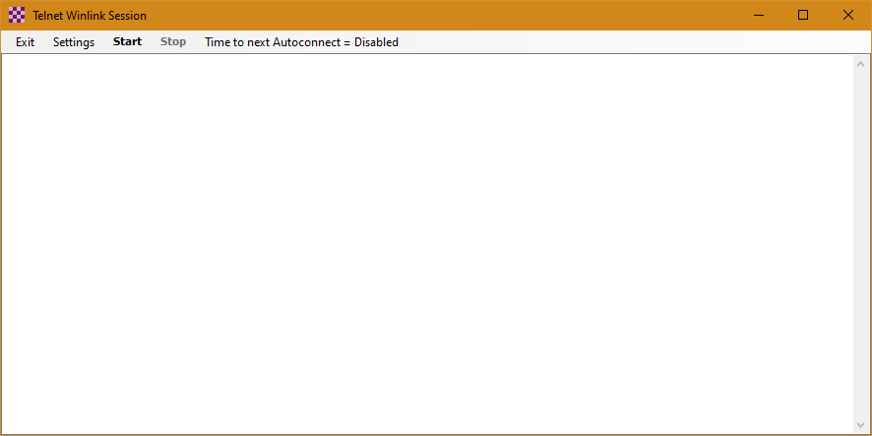
Checking for Messages and Sending New Messages
Click Start

Slide 16
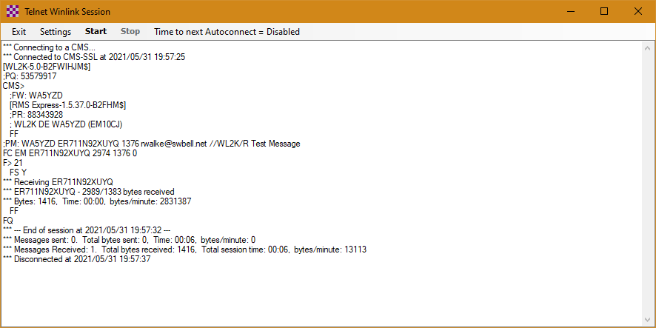
Like Magic this Happens in the Session Window
Click Exit to Close the Telnet Session

Slide 17
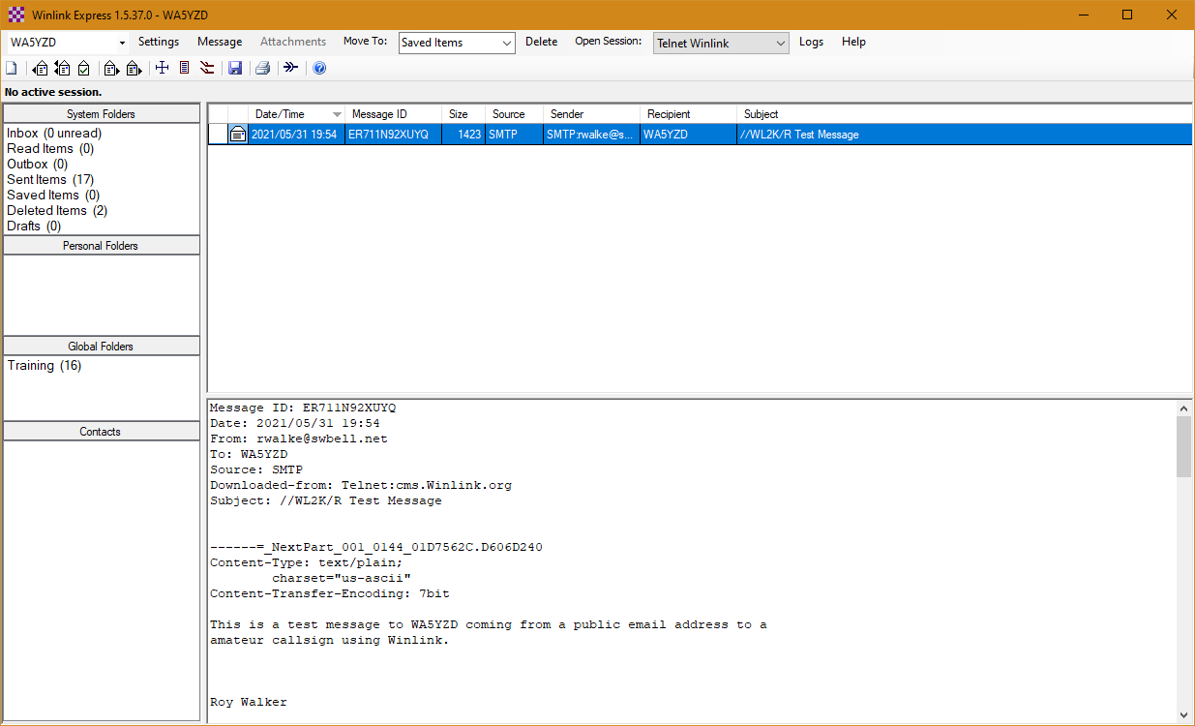
View New Message by Clicking on the Blue Highlighted Test Area

Slide 18
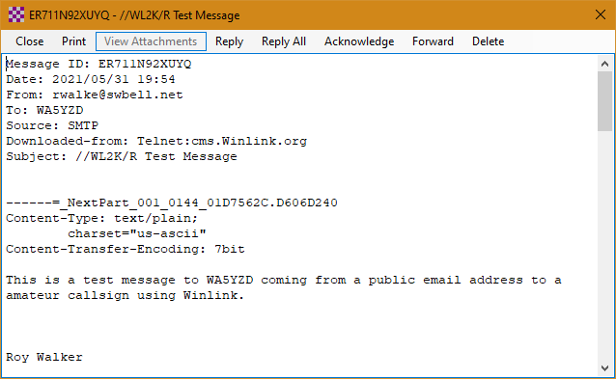
Double Click the Message and a Window Will Open With the New Message

Slide 19
Now We Are Going to Create and Message with a Form Attached
Click Message then New Message
Notes:
Let create a message using a form from one of many in Winlink.

Slide 20
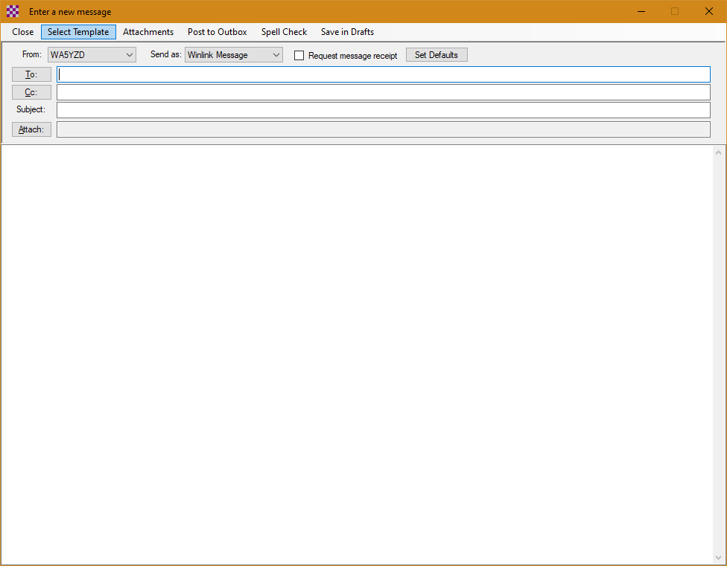
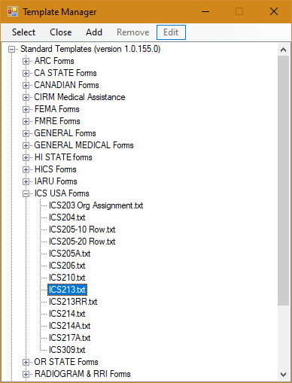
Select Template
This will allow you to select a form to send to someone

Slide 21
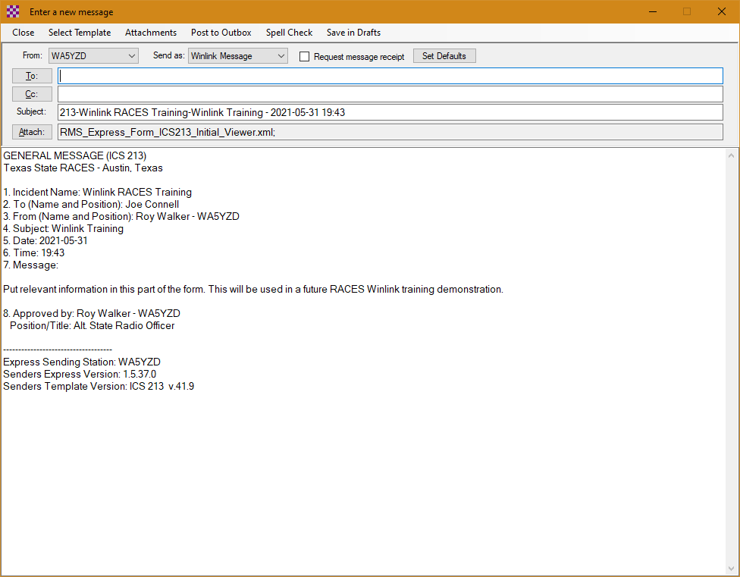
Submit the Form and This Window Will Appear
Insert a Callsign or Email Address and Then Post to Outbox

Slide 22
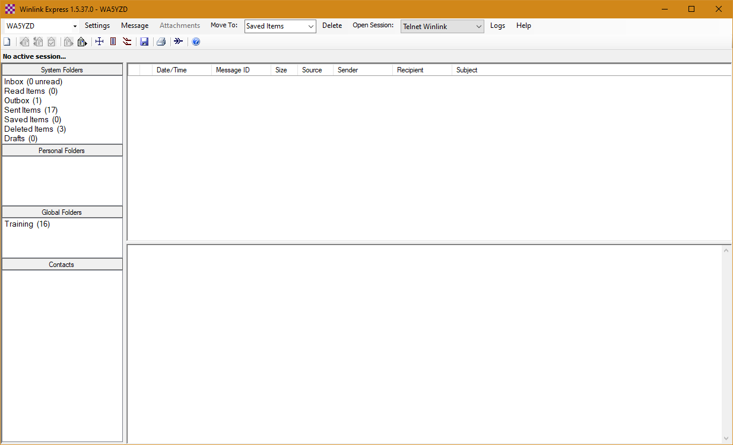
One Message Will Now Show in the Outbox

Slide 23
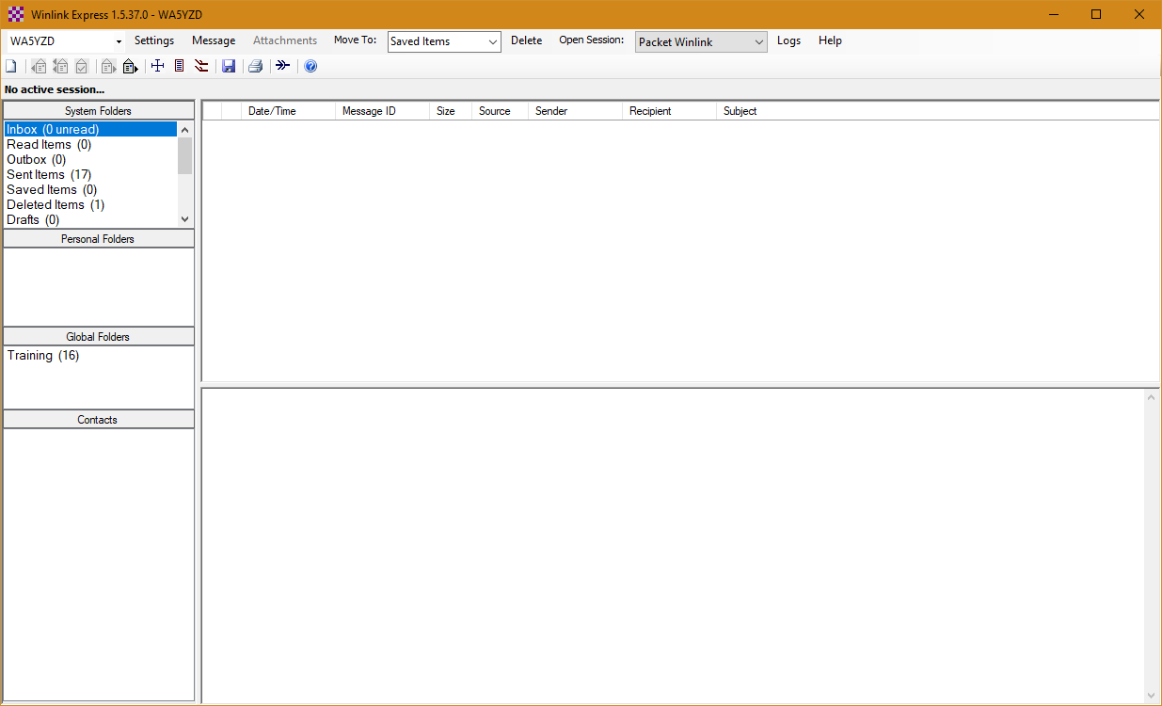
Send the Winlink Message Through a HF, VHF or UHF RMS Station or Use Telnet
Packet
VARA FM
VARA HF
Pactor

Slide 24
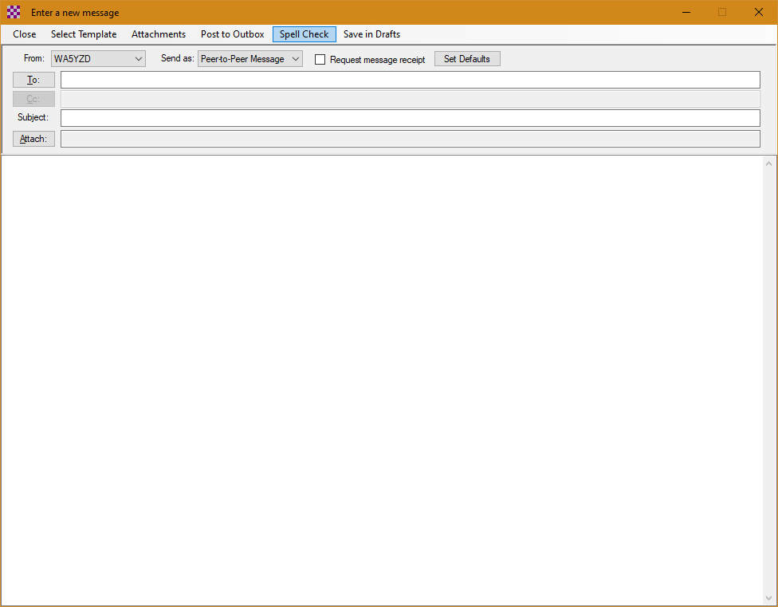
Create a Pier-to-Pier Message
Select Pier-to-Pier in the ‘Send As’ Dropdown Box

Slide 25
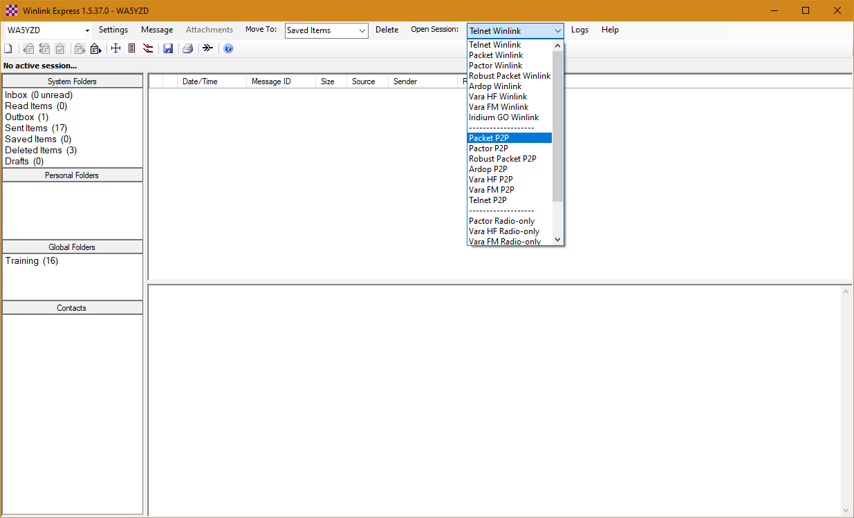
Send Message Prepared Pier-to-Pier Only as a Pier-to-Pier Message
******** If you change your mind and want to send as ‘Winlink Message’, you must create message as ‘Winlink Message’. Copy the text from old P-to-P message and create a new ‘Winlink Message’ then Paste into New Message *******

Slide 26
A Word about P-to-P Message Sending
The Callsign of the Receiving Station Must be in the ‘To’ address
The frequency, mode and time of the send/receive session must be coordinated ahead of time between the two stations
Pay attention to the ‘frequency’ and ‘dial frequency’ when coordinating the session
Either end of a P-2-P session can initiate the message transfer. You can post a message, and the other station receive when connected to you.

Slide 27
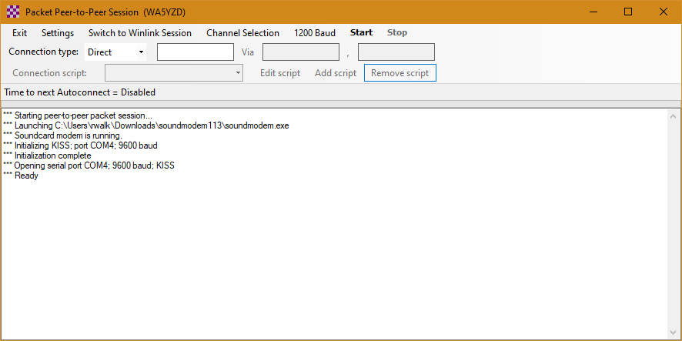
Pier-to-Pier Message Sending
If Direct Put Callsign of Other Station in this Box

Slide 28
Can I Send A Text To A Cell Phone?
YES. It's possible to send an SMS text message to a mobile phone from Winlink using a carrier gateway.
Navigate to GENERAL Forms - Quick Message txt
You must have 2 pieces of information. (1) cell phone number (2) what cell phone provider or carrier
SMS & MMS Access - Text messaging to cell phones. (MMS) 9035633046@vzwpix.com – (SMS) 9035633046@vtext.com
MMS stands for Multimedia Messaging Service - SMS stands for Short Message Service.
Notes:
When Winlink has been installed on you PC or Mac it will look for updates each time you start the program. I t will also ask you to update the forms it contains. All you do is say ‘yes’.

Slide 29
Send a Message to Yourself
From your email client, send an email to:
YourCallsign@Winlink.org
In the subject line put the following:
//WL2K R/Test A Subject of Your Choice Like ‘Test’
Put something in the message of your choosing
Send the Message
The precedence indicator is included in a Winlink message by adding one of the following to the subject line--whether originated from Internet email or from a Winlink address.
//WL2K Z/ - Flash (for urgent message use only)
//WL2K O/ - Immediate (for urgent message use only)
//WL2K P/ - Priority
//WL2K R/ - Routine (Default)

Slide 30
Recap - Q & A
Winlink Express takes time for setup & orientation, but once setup it is relatively easy to use. Training will ensure EmComm users are ready when emergencies arise.
Did I mention FORMS!!
YouTube – Is your friend for setting up Winlink Express, VARA & interfacing radio to PC.
Digirig – Best interface if you rig does not have a built-in sound card.
Always check for updates to Windows, Winlink or VARA software before deploying your station.
WB5EYF@WINLINK.ORG - WB5EYF@HOTMAIL.COM
903.563.3046 – Call, text or email me if you need assistance or have questions.
Is Winlink something your organization might use? Your group may be called upon to respond to an incident to provide Winlink support.
THANK YOU

